Slide 1

Asynchronous
Programming

Slide 2
a
Content
Introduction
Parallelism
Asynchronous Programming
How Requests are Processed by Thread Pool
Processing Asynchronous Requests
Choosing Synchronous vs Asynchronous
Coding Examples (Sync & Async)
Execution Time Difference
1.
2.
3.
4.
5.
6.
7.
8.
….
. . . . . . . . . . .
. . . . . . . . . . .
. . . . . . . . . . .

Slide 3
Introduction
a
As a developer, we all want to develop good software
We also know that good software is one that is Testable, Maintainable, Reusable, Flexible, and Efficient.
When we talk about efficiency, we probably think in terms of speed. For example, let us say we have a program A that performs a task in 60 seconds. And another program B performs the same task in two seconds. We can say that Program B is more efficient than Program
One of the ways to achieve efficiency is to have a faster computer i.e. the computer having more RAM, More CPU, more SSD, etc. Unfortunately, this is going to be expensive and there are also some limitations in terms of RAM, CPU, SSD, etc
. . . . . . . . . . .
. . . . . . . . . . .
. . . . . . . . . . .

Slide 4
Parallelism
a
Another option is Parallelism. The concept of having a Set of Tasks and dividing them into several parts and those several parts can be performed simultaneously is called Parallelism.
How we can Achieve Parallelism in Programming?
In Programming, we can achieve Parallelism by using threads. A thread is a sequence of instructions that can be executed independently of other code. Since they are independent within a process, so we can have several threads.
Asynchronous Programming allows us to use threads efficiently and threads are prevented from being unnecessarily blocked.
. . . . . . . . . . .
. . . . . . . . . . .
. . . . . . . . . . .

Slide 5
Asynchronous Programming
a
To work with asynchronous programming in C# we use async and await keywords.
Async and Await Keywords:
Use async to mark a method as asynchronous.
Use await to wait for an asynchronous operation without blocking the original thread.
Return Types:
An async method must return Task or Task<T>.
Task represents an ongoing operation that doesn’t return a value.
Task<T> is a promise that the method will return a value of type T in the future.
. . . . . . . . . . .
. . . . . . . . . . .
. . . . . . . . . . .

Slide 6
How Requests are Processed by Thread Pool
a
Thread Pool Basics:
A web server has a pool of threads to handle incoming requests.
When a request comes in, a thread from this pool processes it.
Synchronous Requests:
If a request is processed synchronously, the thread is busy and can't handle other requests until it's done.
The thread pool can handle many threads, but there’s a limit (e.g., 5,000 threads by default).
Thread Starvation:
If all threads are busy, new requests have to wait in a queue.
If the queue is full, the server might reject requests with an "HTTP 503: Server Too Busy" error.
Impact of High Latency:
If many long-running requests come in quickly, the server can struggle.
Adding more threads uses more memory and can slow down the server.
Asynchronous Requests:
With asynchronous methods, threads are not tied up while waiting for long operations.
This approach uses fewer threads and less memory, improving server performance.
. . . . . . . . . . .
. . . . . . . . . . .
. . . . . . . . . . .

Slide 7
Processing Asynchronous Requests
a
Asynchronous Requests: In web apps with many requests or sudden spikes in traffic, using asynchronous calls helps the app stay responsive.
An asynchronous request takes the same time to complete as a synchronous one, but it doesn’t tie up a thread while waiting.
This means the server can handle other requests while waiting, preventing delays and avoiding overloading the thread pool.
. . . . . . . . . . .
. . . . . . . . . . .
. . . . . . . . . . .

Slide 8
Choosing Synchronous or Asynchronous Action Methods
a
Here's a simplified guide for choosing between synchronous and asynchronous action methods:
Use Synchronous Methods When:
The tasks are simple and quick.
Simplicity is more important than performance.
The tasks mainly use the CPU, not disk or network resources (asynchronous methods don’t help here and can add extra complexity).
. . . . . . . . . . .
. . . . . . . . . . .
. . . . . . . . . . .

Slide 9
Choosing Synchronous or Asynchronous Action Methods
a
Use Asynchronous Methods When:
You’re calling services that support asynchronous methods, and you're using .NET 4.5 or later.
The tasks involve network or disk operations (asynchronous methods are useful here).
Code simplicity is less important than handling tasks in parallel.
You want to allow users to cancel long-running requests.
Switching threads is worth the overhead (e.g., if a synchronous method is making the thread wait without doing useful work).
Not all methods need to be asynchronous. Often, changing just a few methods can significantly improve performance.
The provided sample code is for learning purposes and may not fully apply to real-world applications.
. . . . . . . . . . .
. . . . . . . . . . .
. . . . . . . . . . .

Slide 10
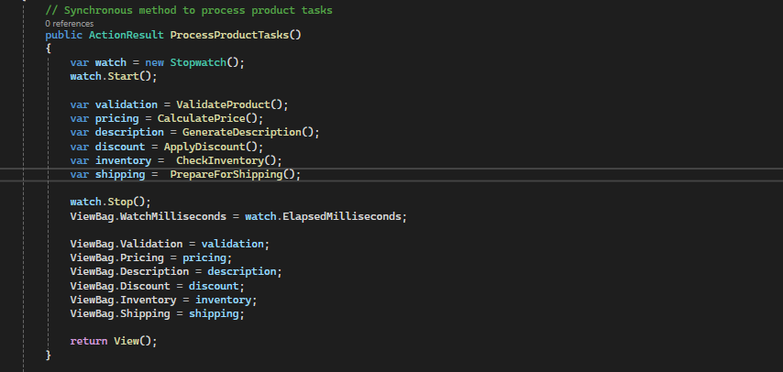
Coding Example (Sync)
a
Controller’s Action Method to Process Product Tasks
. . . . . . . . . . .
. . . . . . . . . . .
. . . . . . . . . . .

Slide 11
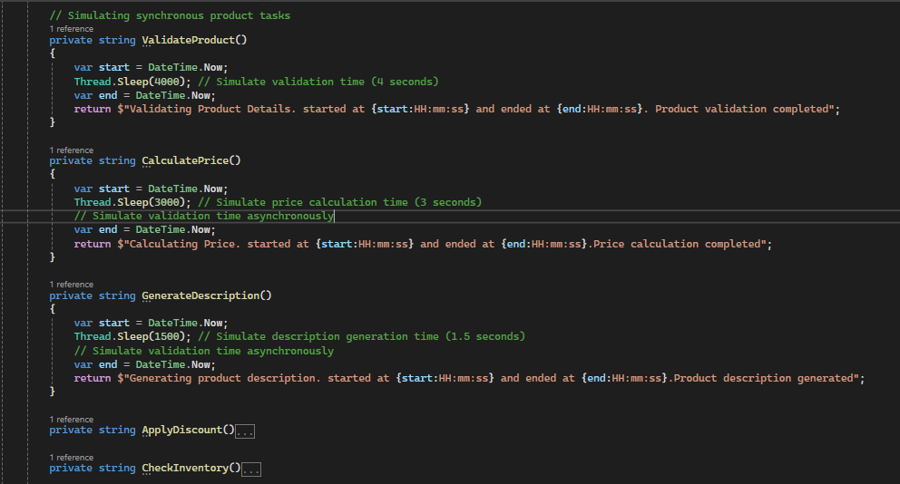
Coding Example (Sync)
a
Functions for validation, Price Calculation, Generating Description…
. . . . . . . . . . .
. . . . . . . . . . .
. . . . . . . . . . .

Slide 12
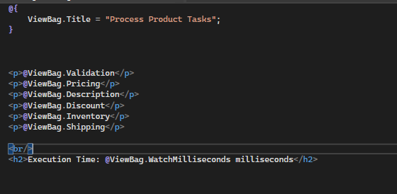
Coding Example (Sync)
a
View For ProcessProduct
. . . . . . . . . . .
. . . . . . . . . . .
. . . . . . . . . . .

Slide 13
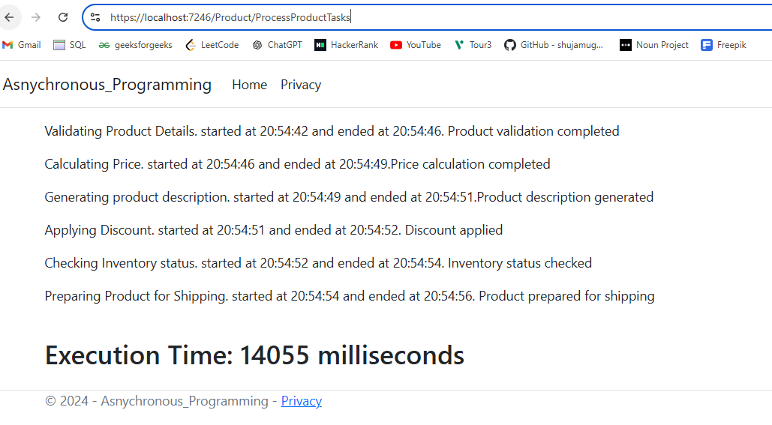
Coding Example (Sync)
a
Output of Synchronous task
. . . . . . . . . . .
. . . . . . . . . . .
. . . . . . . . . . .

Slide 14
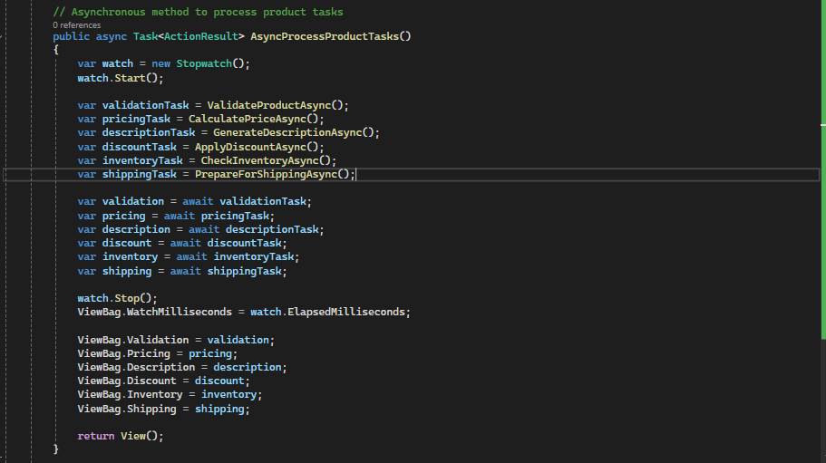
Coding Example (Async)
a
Controller’s Action Method to Process Product Tasks
. . . . . . . . . . .
. . . . . . . . . . .
. . . . . . . . . . .

Slide 15
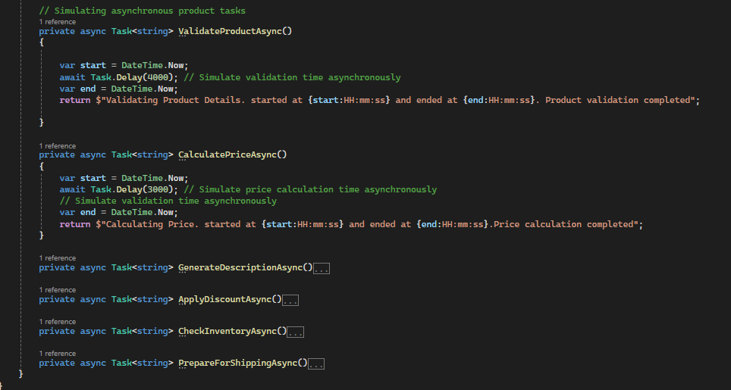
Coding Example (Async)
a
Async Functions for validation, Price Calculation…
. . . . . . . . . . .
. . . . . . . . . . .
. . . . . . . . . . .

Slide 16
Coding Example (Async)
a
View For ProcessProduct
. . . . . . . . . . .
. . . . . . . . . . .
. . . . . . . . . . .

Slide 17
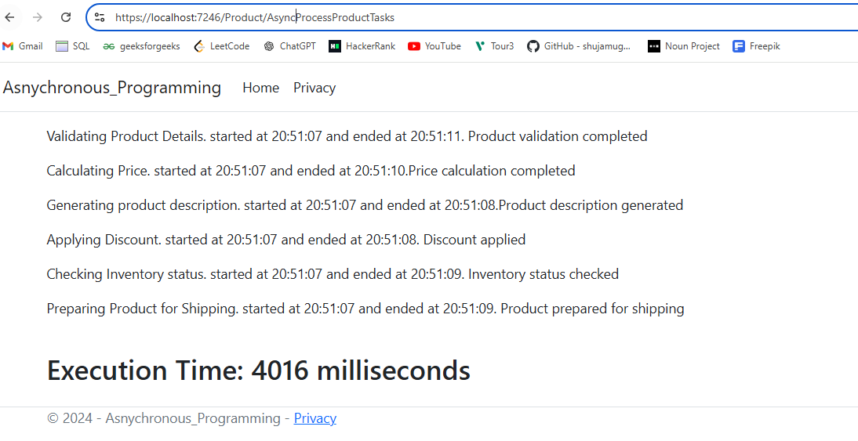
Coding Example (Async)
a
Output of Asynchronous task
. . . . . . . . . . .
. . . . . . . . . . .
. . . . . . . . . . .

Slide 18
Execution Time Difference
Synchronous Code Output
Asynchronous Code Output

Slide 19
a
Thank You!
. . . . . . . . . . .
. . . . . . . . . . .
. . . . . . . . . . .

